Slide 1







Technology Trends and Analysis Presentation
Do Duy Tan
23 – 05 -2023

Slide 2




OUTLINE
Executive Summary
Introduction
Methodology
Results
Visualization – Charts
Dashboard
Discussion
Findings & Implications
Conclusion
Appendix

Slide 3

EXECUTIVE SUMMARY
Trends in programming languages and databases
﻿﻿Demographics survey
﻿﻿Technological gap in countries
﻿﻿Gender gap in jobs

Slide 4

INTRODUCTION
About:
Analyzing the trends in software development
Purpose:
• Identify skill requirements for future
• What are the top programming languages in demand?
• What are the top database skills in demand?
• What are the popular IDEs

Slide 5

METHODOLOGY
﻿﻿Data Collection Sources
﻿﻿Stack Overflow Developer 2019 Survey
﻿﻿GitHub Job Postings
﻿﻿Programming Languages Annual Salary
﻿﻿Data Exploration
﻿﻿Data Cleaning
﻿﻿Data Visualization
﻿﻿Presentation

Slide 6
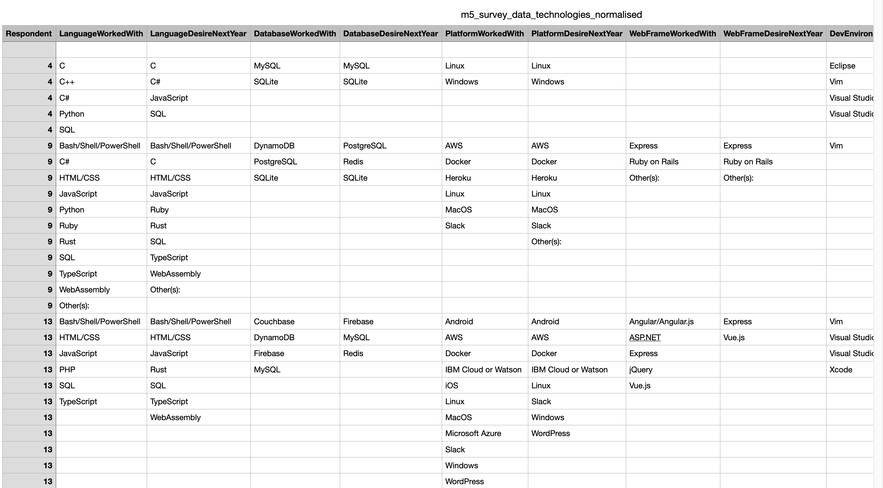
RESULTS

Slide 7
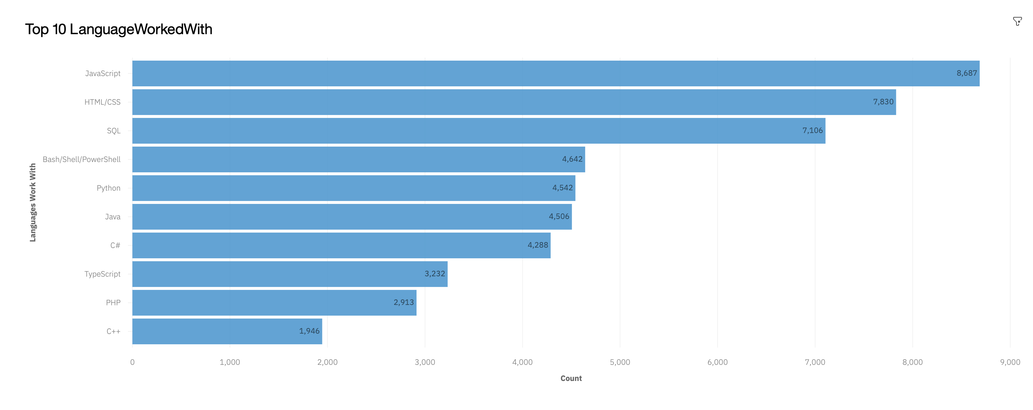
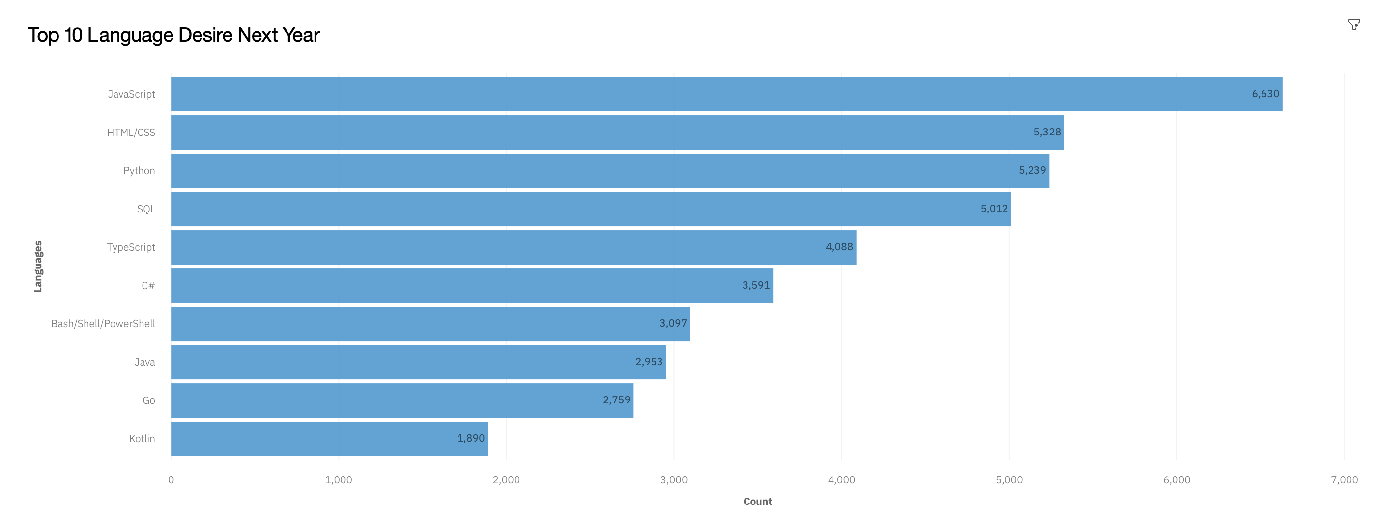
PROGRAMMING LANGUAGE TRENDS
Current Year
Next Year

Slide 8
PROGRAMMING LANGUAGE TRENDS - FINDINGS & IMPLICATIONS
Findings
JavaScript, HTML/CSS, SQL are top 3 this year.
﻿﻿Python and Typescript becoming popular next year.
﻿﻿C++ and PHP is out of top 10 next year.
Implications
Web development (HTML/CSS & JAVASCRIPT) are still in high demand.
﻿﻿Big Data technology in companies still requires SQL
﻿﻿With Al and Machine Learning in rising demand, Python is best choice

Slide 9
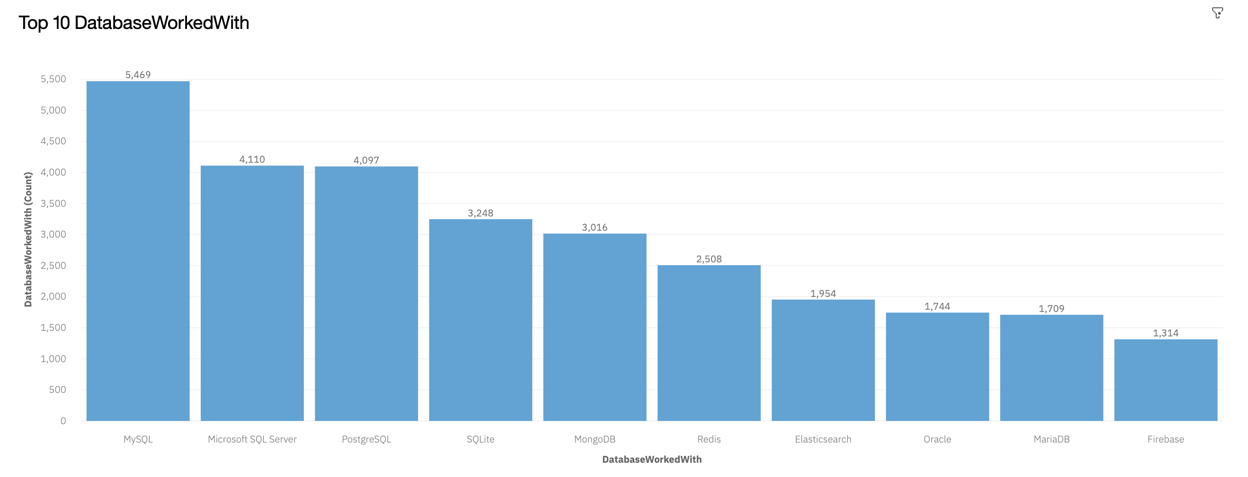
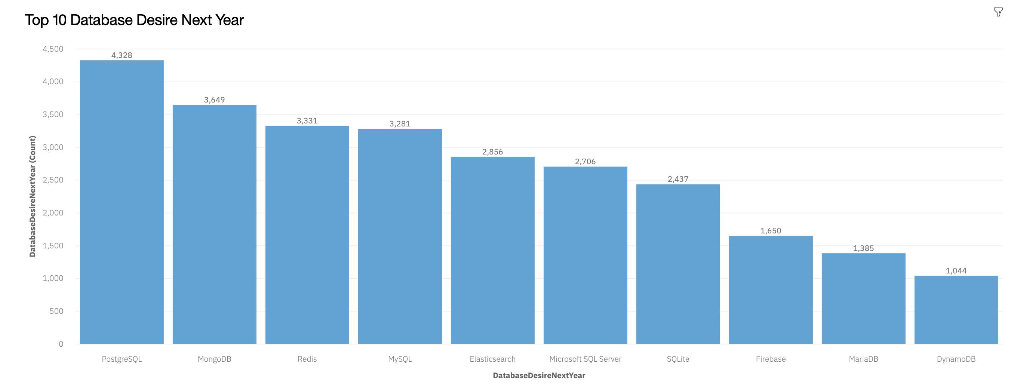
DATABASE TRENDS
Current Year
Next Year

Slide 10
DATABASE TRENDS - FINDINGS & IMPLICATIONS
Findings
MySQL, Microsoft SQL Sever, PostgreSQL are in top 3 this year.
Oracle is out top 10 next year.
MongoDB, Redis are in top 3 next year and PostgreSQL is the best in next year
Implications
Open source databases are still preferable in companies
﻿﻿NoSQL databases will make an impact for storing non relational data
﻿﻿Redis supports abstract data types
﻿﻿Pre tuned search to website, app, or ecommerce store

Slide 11

DASHBOARD
https://dataplatform.cloud.ibm.com/dashboards/4e234460-e69c-4311-b26e-497997a64683/view/7d62f43b1a8837966af0e6e4079829017a647354e4bbd10780d77b490a332097a96a1b95c87c1d528c115364f2ee120bc8

Slide 12
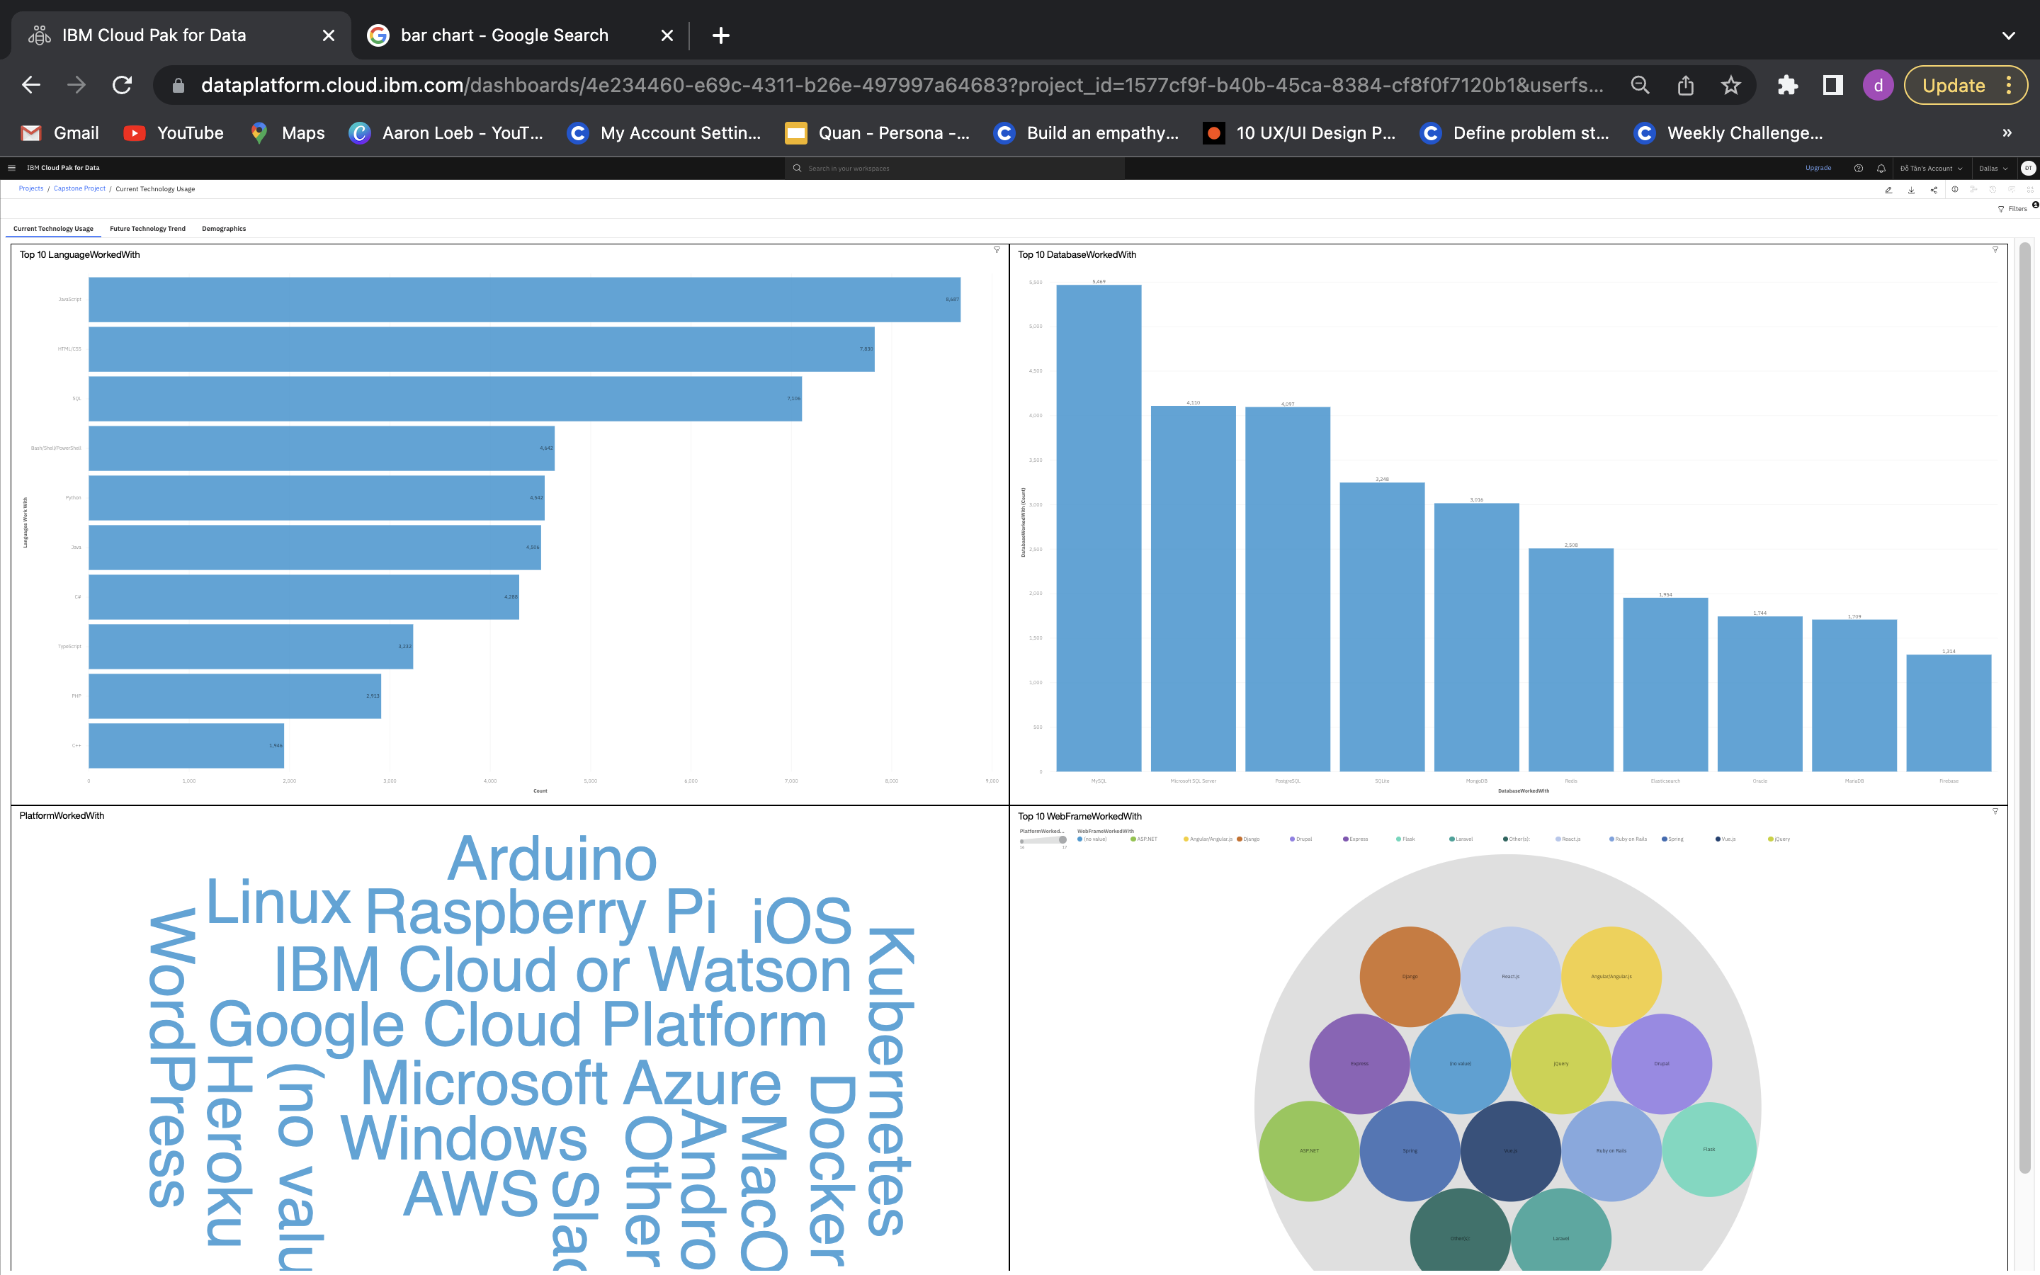
DASHBOARD TAB 1

Slide 13
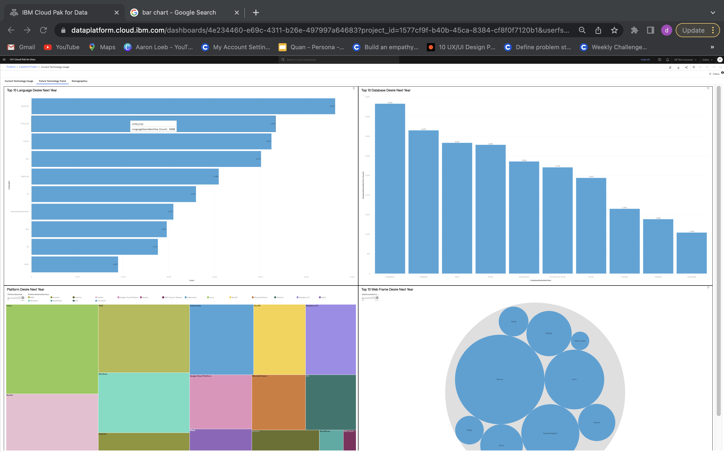
DASHBOARD TAB 2

Slide 14
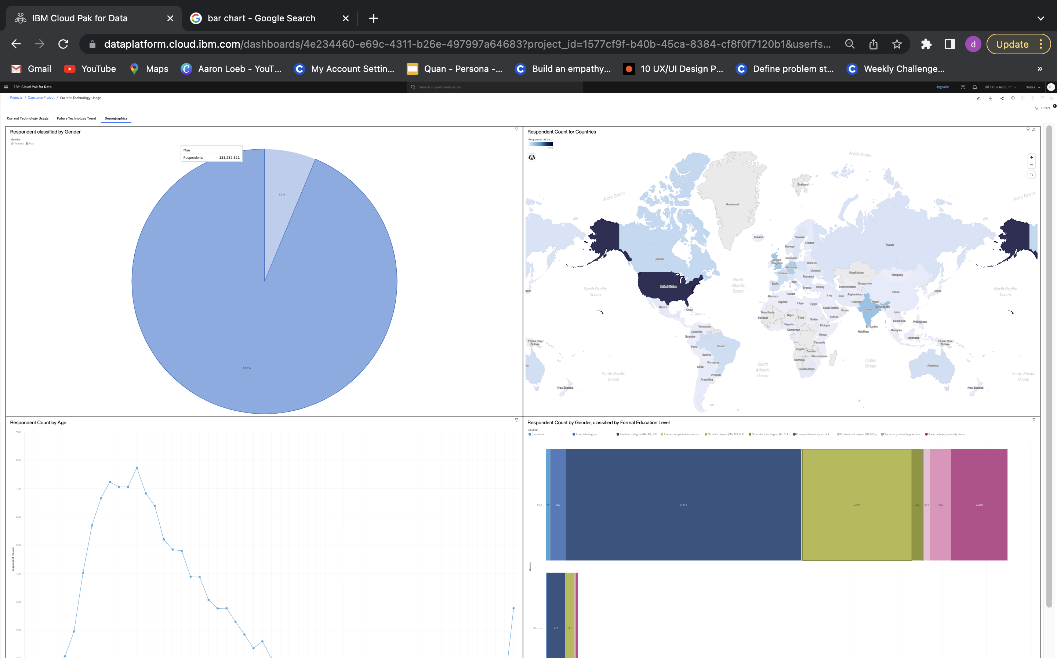
DASHBOARD TAB 3

Slide 15
DISCUSSION
Technology Trends now and future
﻿﻿Training and Reskilling workers
﻿﻿Females participation in Technology field
﻿﻿Bridge divide of technology gaps in developing countries
﻿﻿Eliminate age and education discrimination in employment

Slide 16
OVERALL FINDINGS & IMPLICATIONS
Findings
Fast changing technology every year
﻿﻿Concentration on several countries like USA and India
﻿﻿Gender gap in technology jobs
﻿﻿Platforms like Docker and AWS are growing
Implications
Companies need to be flexible and adjust to rapid changes
﻿﻿Need to spread technology out to lagging countries
﻿﻿Impact of job hiring's
﻿﻿Shift to faster app deployments and cloud services in future

Slide 17

CONCLUSION
Technology Trends for current and next year
﻿﻿Programming Languages, Database and Platform overview
﻿﻿Demographics overview
﻿﻿Actions to be taken
﻿﻿In future, incorporate Machine Learning to predict trends and salaries

Slide 18
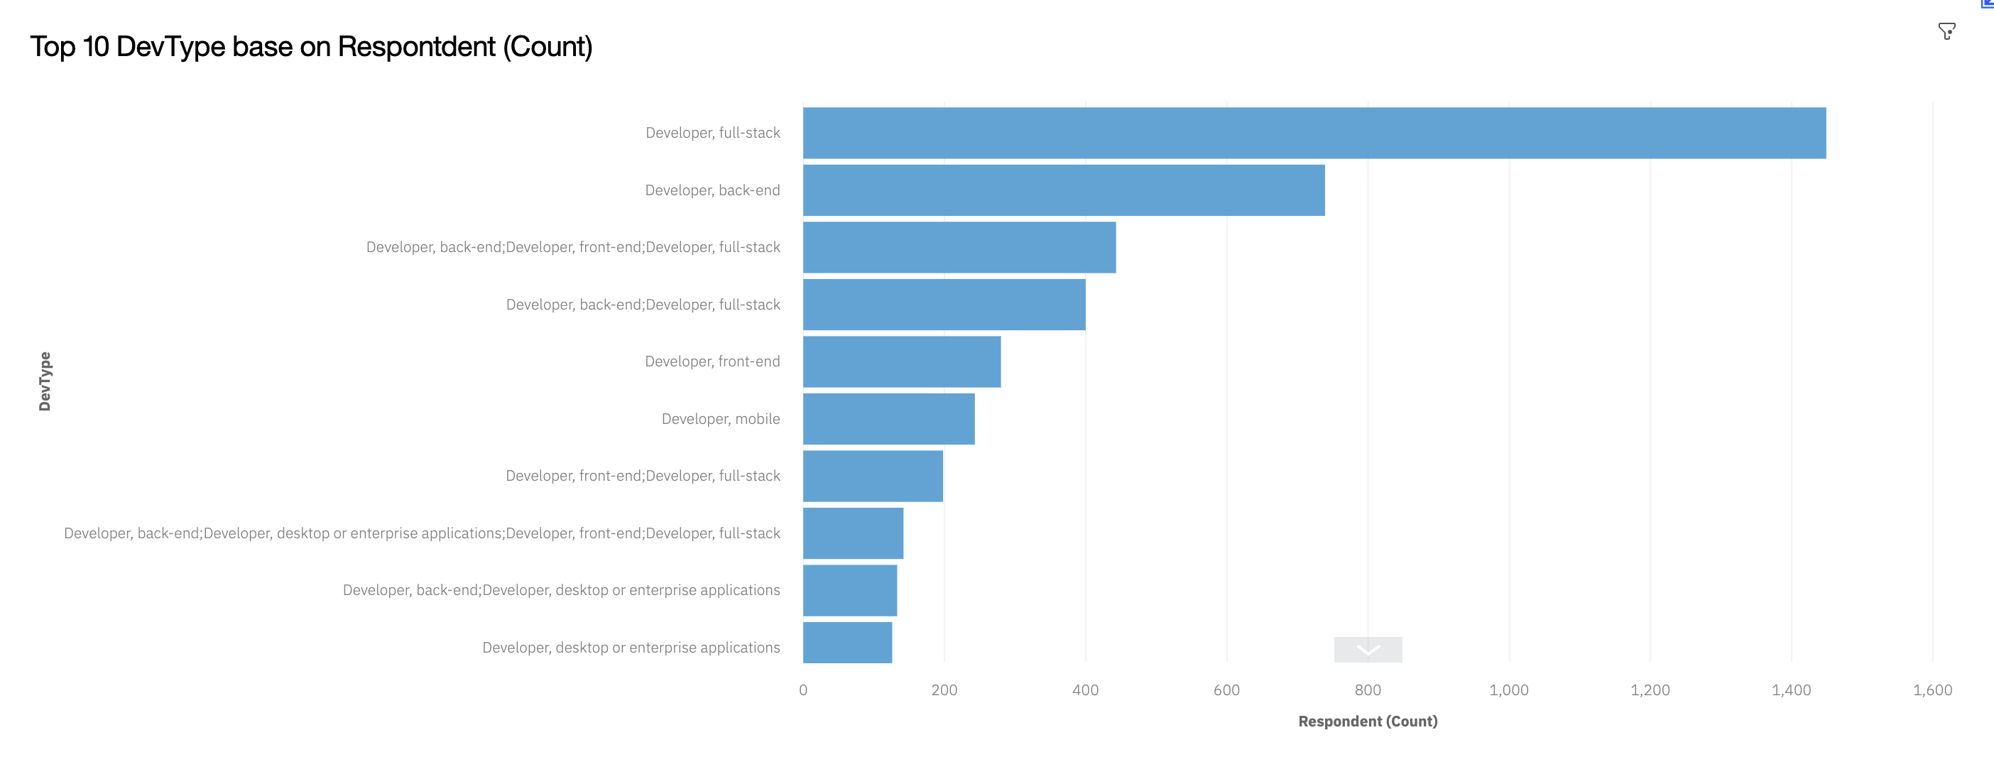

APPENDIX

Slide 19
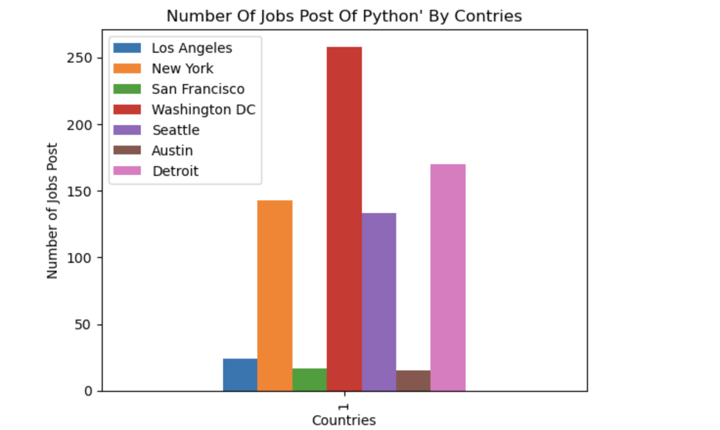
JOB POSTINGS
In Module 1 you have collected the job posting data using Job API in a file named “job-postings.xlsx”. Present that data using a bar chart here. Order the bar chart in the descending order of the number of job postings.

Slide 20
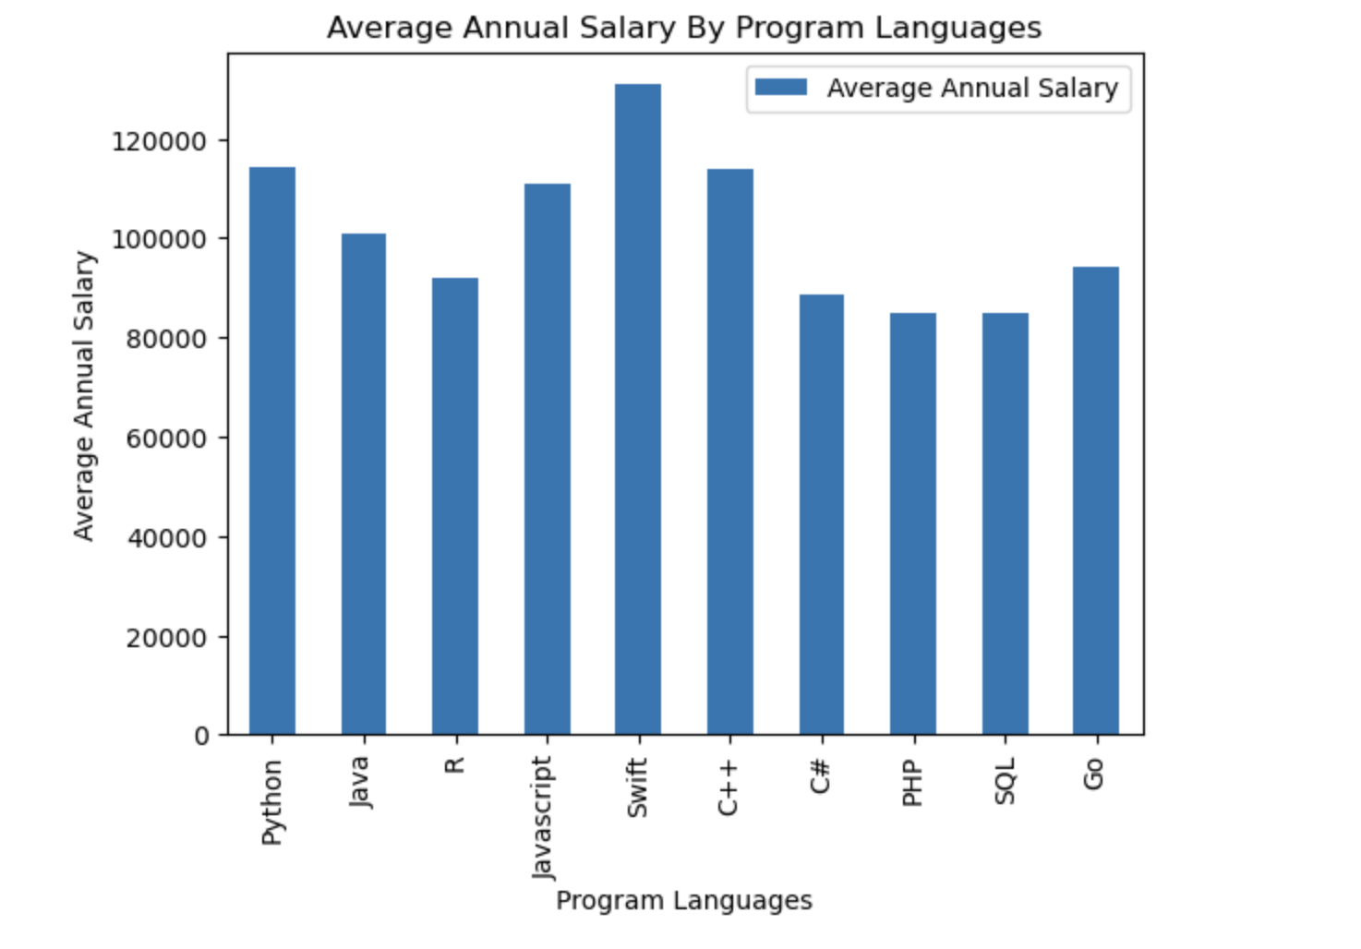
POPULAR LANGUAGES
In Module 1 you have collected the job postings data using web scraping in a file named “popular-languages.csv”. Present that data using a bar chart here. Order the bar chart in the descending order of salary.

